Slide 2
Clinical Leadership Decision Process
Clinical Outcomes
Cost
Reimbursement
How can you balance positive patient outcomes & costs of new, expensive therapies?
Roger Williams Medical Center a CharterCare Health Partner
Presenters: Mark Curtis RPh Pharmacy Clinical Coordinator
Ron Lombardi RPh Pharmacy Reimbursement Coordinator

Slide 3
Objectives:
Review how goals of patient therapy, outcomes, cost and reimbursement can be evaluated.
Consider the Impact of New Expensive therapies on Hospital Finances.
Demonstrate how using a data base can help in the present and future decision making process.

Slide 4
Disclosures
Presenter: Mark Curtis RPh Pharmacy Clinical Coordinator
Has no financial disclosures to report
Presenter: Ron Lombardi RPh Pharmacy Reimbursement Coordinator
Has no financial disclosures to report
Roger Williams Medical Center a CharterCare Health Partner

Slide 5
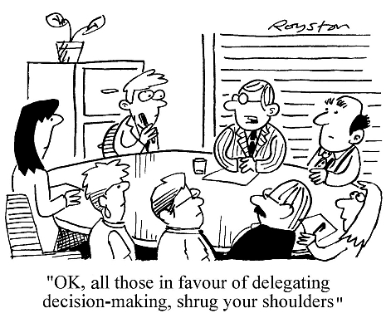

Slide 6
Costs:

Slide 7
Costs:
Yervoy® Ipilimumab
3 mg/kg every 3 weeks for 4 doses
Arzerra® Ofatumumab
300 mg week 1 then 2000 mg weekly x7 doses then 2000 mg every 4 weeks x4
Perjeta® Pertuzumab
840 mg x1 then 420 mg every 3 weeks

Slide 8
Goals: Use a Multidisciplinary Team to…
Evaluate requested therapy for an approved use
Determine/and get Prior Authorization by insurance company
Evaluate Any Adverse Drug Events associated with therapy
Evaluate the overall financial impact on the institution and the patient
Compare the expectations of therapy vs experience
Determine if this therapy will be added to the formulary

Slide 9
The Team:
Decision Committee
Chief of Surgery
Director of HemOnc BMT
Director of Pharmacy
Pharmacy Clinical Coordinator
Pharmacy Reimbursement Coordinator
Director of the Cancer Center
Chairman of the P&T Committee
Chief of Medicine

Slide 10
Decision Committee
The Process:
The Doctor submits a request with justification (clinical indication) for use
The Request is researched, for FDA approved use, need for prior authorization, etc.
The updated request is sent to the committee members for review
The committee decides if the request is approved (24-48 hours turn around time)

Slide 11
Decision Committee
The Post Approval Process:
The patient’s therapy is monitored for benefits and adverse events
The cost and reimbursement data is analyzed
The outcomes are reported to the P&T Committee and Medical Executive Committee
The experience is documented for future requests and formulary consideration
Decision Committee Data Base

Slide 12
Considerations:
Why not just have the Pharmacy and Therapeutics Committee decide?
Why not just use a Non Formulary Request Process?

Slide 13
Reimbursement Considerations:
Evaluate Patient’s Insurance Information (both primary and secondary)
Collaborate with Hospital PFS and Insurance Provider Services to Determine:
*Prior Authorization Requirement(s)
*HCPCS Code(s) (J,C,Q code)
*Billable Units and Estimated Reimbursement
Estimated Cost of Proposed Therapy (>$1M to Date)
Determine Patient’s Financial Responsibility *Explore PAP when Necessary

Slide 14
Charges and Payment
CharterCare is a MEDITECH Organization
Monitor Correct Charge Submission in the Pharmacy System
Track Claim in B/AR
Access Remittance Report
*HCPCS Code
*Billable Units
*Charges Recorded
*Actual Reimbursement

Slide 15
Charges and Payment
Document Actual Cost and Reimbursement in Database
Continue to Monitor Each Dose/Cycle and Document
Coordinate Payment Appeal if Necessary

Slide 16
Considerations:
Lessons Learned
Added Expectations of Therapy to the Initial Request
Gained experience of Coverage per Payer
Clinical Outcomes…ADE’s and Benefits
Add to Formulary?

Slide 17
Future Thinking:
Where are we going from here?

Slide 18
Presentation Questions
1. Which of the following need to be considered when new therapies are requested?
A. Clinical justification and therapy goals
B. Cost of Therapy & Reimbursement
C. FDA approved indication and published articles
D. Outcomes from past experience
E. All of the Above
2. True or False: Once a health care payer reimburses for a therapy on one patient, it can be assumed that they will reimburse on another patient with the same coverage.
3. True or False: A database can be used to evaluate past experiences and help support future decisions for new therapy requests.

Slide 19
Presentation Questions
1. Which of the following need to be considered when new therapies are requested?
A. Clinical justification and therapy goals
B. Cost of Therapy & Reimbursement
C. FDA approved indication and published articles
D. Outcomes from past experience
E. All of the Above
2. True or False: Once a health care payer reimburses for a therapy on one patient, it can be assumed that they will reimburse on another patient with the same coverage.
3. True or False: A database can be used to evaluate past experiences and help support future decisions for new therapy requests.

Slide 20
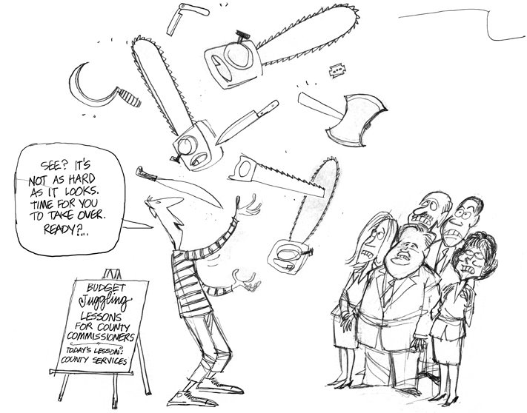

Slide 21
QUESTIONS?

