Slide 1
Business Intelligence
What It Is
How It Breaks
How To Get It
RISHP Showcase
Saturday, November 2nd, 2013

Slide 2
Disclosure
Louis Palmisciano and Kristen Bunnell report no relevant financial relationships.

Slide 3
Your Speakers
Louis Palmisciano
Pharmacy Business Operations & Clinical Intelligence Team Lead
BS in information technology
Over a decade of technology experience in the investment and healthcare sectors
lpalmisciano1@lifespan.org
Kristen Bunnell
Clinical Pharmacist Specialist in Critical Care
kbunnell@lifespan.org

Slide 4
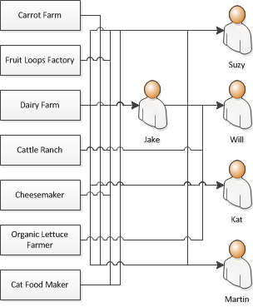
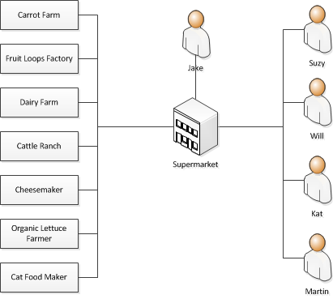
What It Is Why The World Needs “Middle Men”

Slide 5
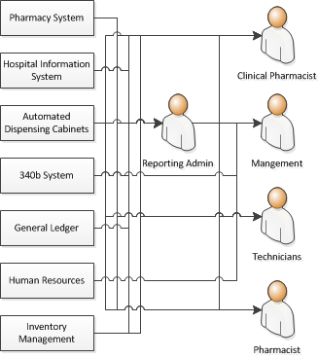
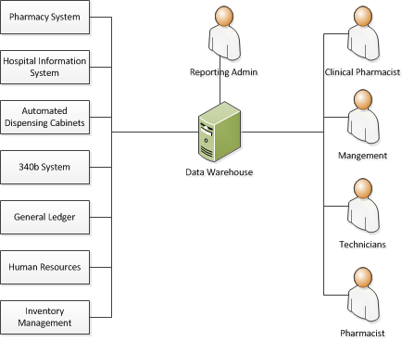
What It Is Why The World Needs Business Intelligence

Slide 6
What It Is Anatomy of A Business Intelligence Operation
Database Technologies
#SQL Server# (central instance for data)
#SQL Server Express# (decentralized stored procedures only)
#Microsoft Access# (functionality only , no data stored)
#ODBC# (data connection)

Slide 7
Simple Data Report
Medication Monitoring

Slide 8
How It Breaks #Cognitive Bias#
#Multiple Comparisons#
The more measures you compare for any intervention the more likely it will be that the intervention will appear to be effective by random chance alone.
Decide on a measurement strategy before reviewing data and stick with it. If you use more than one measurement, use them all in decision making, don’t pick the one that looks best and disregard the rest.
#Observer Expectancy Effect#
There are many ways for an observer to unconsciously affect patient behavior and subjective measurements. Observers tend to find what they expect to find, regardless of reality.
Whenever possible use objective data rather than subjective. If subjective data is required it should be gathered by a disinterested party.

Slide 9
How To Get It How To Hire A Technology Professional
Logical thinker that loves complex problems
Ask your applicants a logic problem that has no real answer, “I’m building a town for 10,000 people, how many gas stations should I build?”. You want someone that can attack the question logically and with enthusiasm.
History of automating or adding efficiency
Your applicant should be not able to perform inefficient processes without making them more efficient.
A builder
There are more professionals that work in “technology” that cannot build solutions themselves than there are professionals that can.
Self teaching
Ask your applicant “How do you learn to do something new?”, the answer you should expect is “I search the internet”.
Particular systems don’t matter
A technology professional’s experience applies to different systems and businesses, even if they’ve never worked with that system or business before.

Slide 10
Complex Data Query
Retrospective Outcomes Research

Slide 11
Research
Research question
Does missing doses of chemical venous thromboembolism prophylaxis increase a patient’s risk of venous thromboembolism?
Medication-related data point
% of doses missed in the first 7 days
What in the pharmacy system can tell us about doses received?
Doses received
x
100%
Possible doses in 7 days
(Days on heparin x 3) +
(Days on enoxaparin x 2)
Stop dates on medication orders in CPOE

Slide 12
Research- DVT Prophylaxis
Doses received
Medication administration record
Order start and stop dates in CPOE
Charges

Slide 13
Research- DVT Prophylaxis
date of admission + 7 days
enoxaparin 30mg; enoxaparin 40mg; heparin 5000 units

